Slide 1
Chongqing University of Technology
ATAI
Advanced Technique of Artificial Intelligence
Chongqing University of Technology
Graph Entropy Guided Node Embedding Dimension Selection
for Graph Neural Networks
Gongxu Luo1;2 , Jianxin Li1;2 , Jianlin Su3 , Hao Peng1 , Carl Yang4 , Lichao Sun5 ,
Philip S. Yu6 and Lifang He 5
1Beijing Advanced Innovation Center for Big Data and Brain Computing, Beihang University, China
2School of Computer Science and Engineering, Beihang University, China
3 Shenzhen Zhuiyi Technology Co., Ltd, China
4Department of Computer Science, Emory University, USA
5Department of Computer Science and Engineering, Lehigh University, USA
6Department of Computer Science, University of Illinois at Chicago, USA
fluogx, lijx, penghao g@act.buaa.edu.cn, bojonesu@wezhuiyi.com, j.carlyang@emory.edu,
psyu@uic.edu, flis221,lih319g@lehigh.edu
Code : https://github.com/RingBDStack/MinGE
IJCAI_2021
Reported by Xinsheng Wang

Slide 2
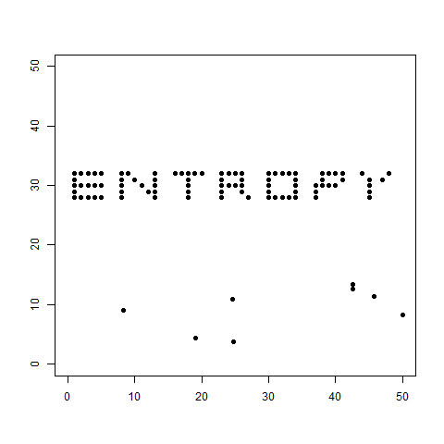
Introduction
Notes:
熵最小，这个时候最有秩序；而被打乱的时候，熵开始增大，直到最后一片混乱，熵变成最大。
i代表事件，n代表事件总数，Pi代表事件发生的概率。公式表明，熵越小，信息不确定性越低，也就意味着更多有用的信息。

Slide 3
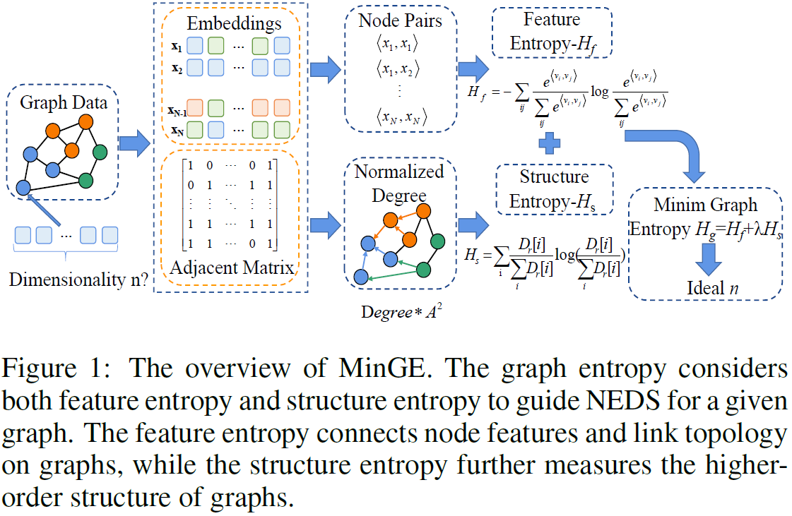
Method

Slide 4
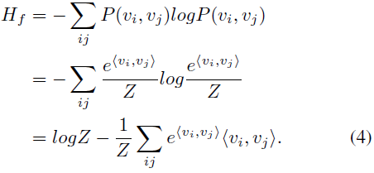
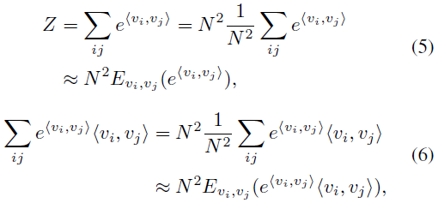
Method
Feature Entropy
Notes:
点积(内积)

Slide 5
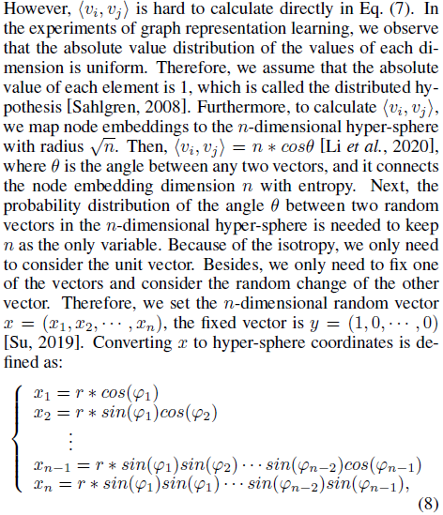
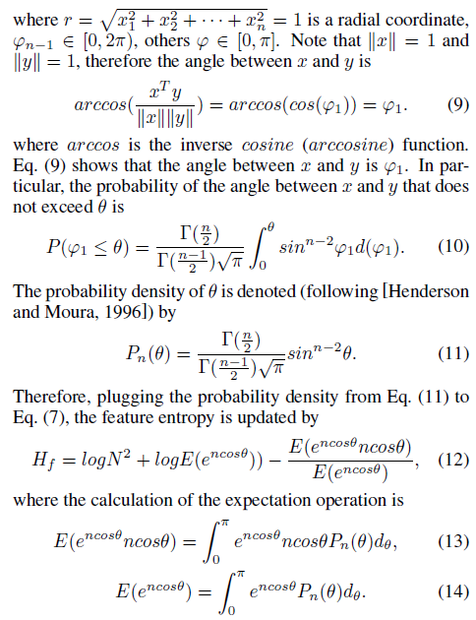
Method
Notes:
点积(内积)

Slide 6
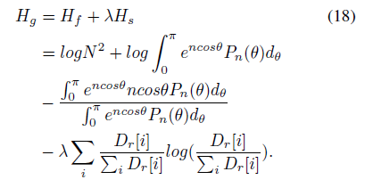
Method
Structure Entropy
Notes:
点积(内积)

Slide 7
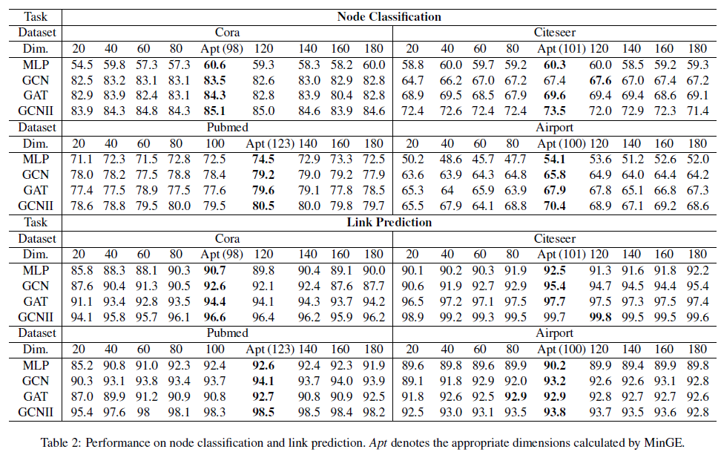
Experiments

Slide 8
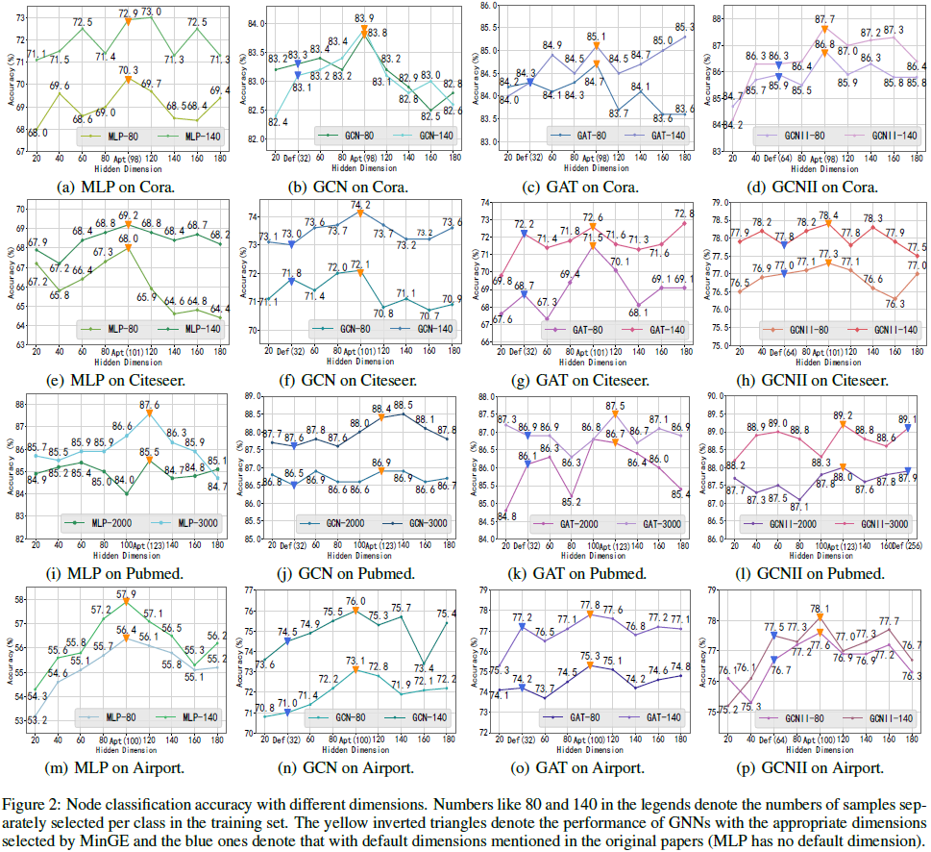
Experiments

Slide 9
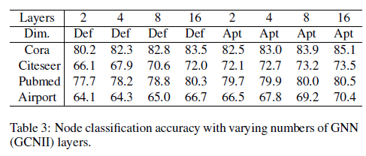
Experiments

Slide 10
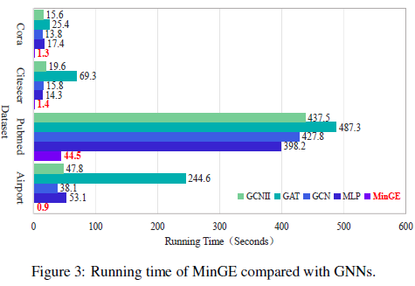
Experiments

Slide 11
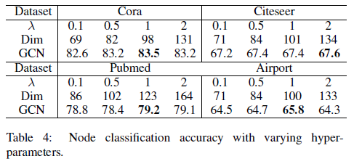
Experiments

Slide 12
Thank you!

